Slide 1
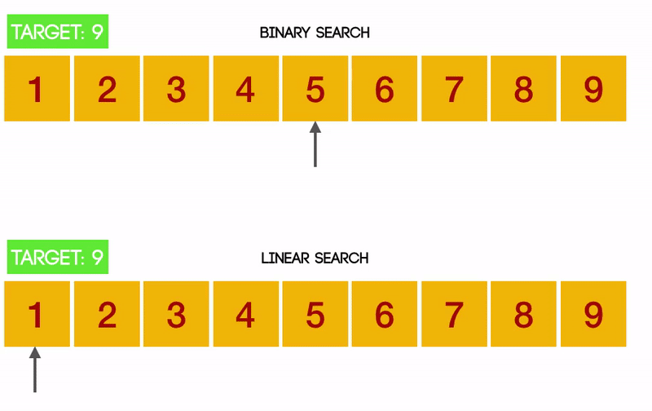
CSE214: Algorithms
Searching Algorithms
‹#›
Notes:
‹#›

Slide 2
Today’s Contents
Different Types of Algorithms Algorithm?
Searching Algorithms
Complexity Analysis of Searching Algorithms
Questions for You!
‹#›
Notes:
‹#›

Slide 3
Algorithms we are going to study
Searching Algorithms
Sorting Algorithms
Greedy Approaches
Dynamic Programming
Graph Algorithms
‹#›
Notes:
‹#›

Slide 4

Searching Algorithms
‹#›
Notes:
‹#›

Slide 5
Searching Algorithms
Search for a target data from a data set.
Searching Algorithms are designed to check for an element or retrieve an element from any data structure where it is stored.
Two possible outcomes
Target data is Found (Success)
Target data is not Found (Failure)
‹#›
Notes:
‹#›

Slide 6
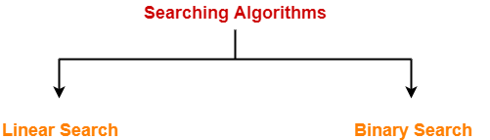
Types of Searching Algorithms
Based on the type of search operation, two popular algorithms available:
Linear Search / Sequential Search
Binary Search
‹#›
Notes:
‹#›

Slide 7
1. Linear Search
It is also known as Sequential Search
Linear search is a very basic and simple search algorithm.
The data list or array is traversed sequentially and every element is checked.
‹#›
Notes:
‹#›

Slide 8
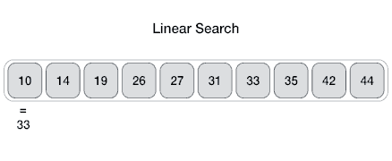
Simulation of Linear Search
Check each and every data in the list till the desired element or value is found.
Suppose, we want to search 33 from the given array, Searching will start from the first index and stop searching if the data is found or the list is over.
‹#›
Notes:
‹#›

Slide 9
Algorithm of Linear Search
Algorithm:
i = 1
while i <= n && Z != X[i] do
i = i+1
if i < n then
FOUND
else
NOT FOUND
flag = FALSE
for i = 1 to n
if A[i] == key
flag = TRUE;
if flag == TRUE
FOUND
else
NOT FOUND
‹#›
Notes:
‹#›

Slide 10
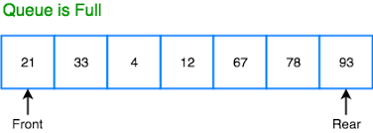
Complexity Analysis of Linear Search
Algorithm:
flag = FALSE
for i = 1 to n
if A[i] == key
flag = TRUE;
if flag == TRUE
FOUND
else
NOT FOUND
Best case: O(1)
Worst Case: O(n)
‹#›
Notes:
‹#›

Slide 11
Features of Linear Search Algorithm
It is used for unsorted and unordered small list of elements.
It has a time complexity of O(n), which means the time is linearly dependent on the number of elements, which is not bad, but not that good too.
It has a very simple implementation.
‹#›
Notes:
‹#›

Slide 12
2. Binary Search
Binary Search is used with sorted array or list.
In binary search, we follow the following steps:
We start by comparing the element to be searched with the element in the middle of the list/array.
If we get a match, we return the index of the middle element.
If we do not get a match, we check whether the element to be searched is less or greater than in value than the middle element.
If the element/number to be searched is greater in value than the middle number, then we pick the elements on the right side of the middle element (as the list/array is sorted, hence on the right, we will have all the numbers greater than the middle number), and start again from the step 1.
If the element/number to be searched is lesser in value than the middle number, then we pick the elements on the left side of the middle element, and start again from the step 1.
‹#›
Notes:
‹#›

Slide 13
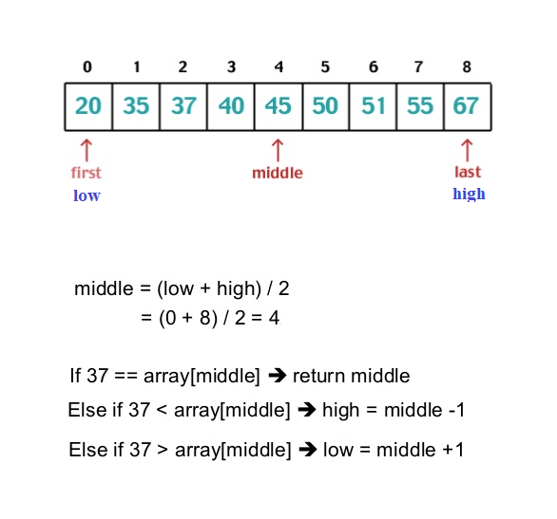
Basic Idea of Binary Search
‹#›
Notes:
‹#›

Slide 14
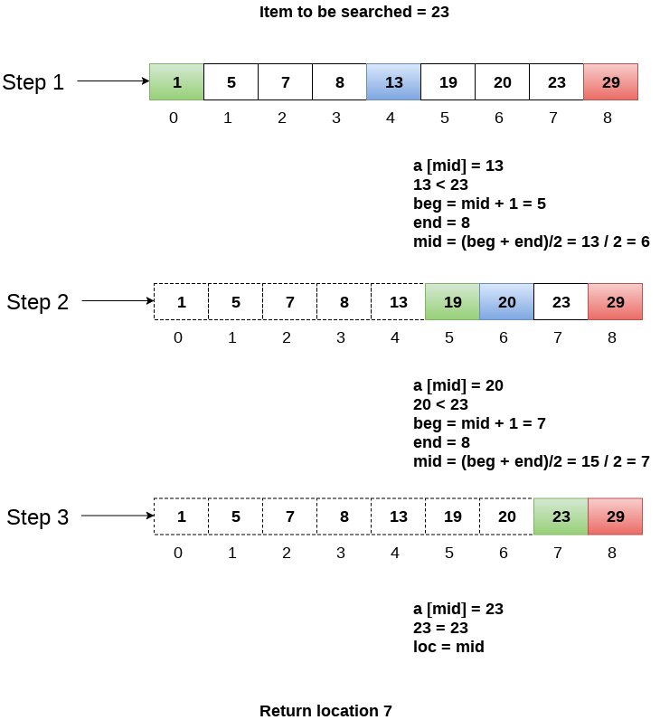
‹#›
Notes:
‹#›

Slide 15
‹#›
Notes:
‹#›

Slide 16
‹#›
Notes:
‹#›

Slide 17
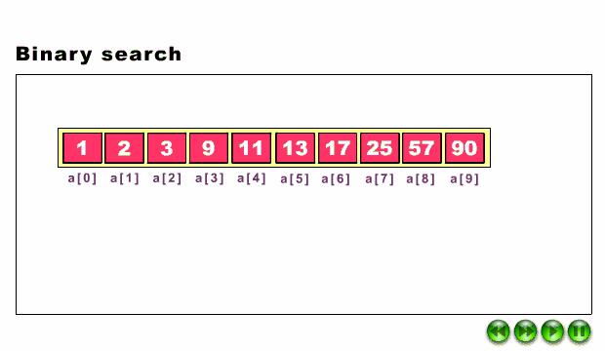
Simulation of Binay Search
‹#›
Notes:
‹#›

Slide 18
Algorithm of Binary Search
Algorithm:
low = 1 //[Start position]
high = n //[Last position]
flag = false
while low <= high and flag = = false do
mid = (l+h) / 2
Xm = A[mid]
case:
Xm < Z : low = mid + 1
Xm > Z : high = mid - 1
Xm = = Z : flag = true
if flag = = true
FOUND
else
NOT FOUND
‹#›
Notes:
‹#›

Slide 19
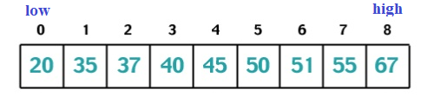
Search 55
mid
low = 0
high = n-1
flag = false
while low <= high and flag = = false do
mid = (low +high) / 2
Xm = A[mid]
case:
Xm < Z : low = mid + 1
Xm > Z : high = mid - 1
Xm = = Z : flag = true
if flag = = true
FOUND
else
NOT FOUND
mid
low
mid
low
Step-1: mid = (low + high ) / 2 = (0 + 8) /2 = 4
A[mid] = 45 < 55
low = mid + 1 = 5
Step-2: mid = (low + high ) / 2 = (5 + 8) /2 = 6
A[mid] = 51 < 55
low = mid + 1 = 7
Step-3: mid = (low + high ) / 2 = (7 + 8) /2 = 7
A[mid] = 55 == 55
found
‹#›
Notes:
‹#›

Slide 20
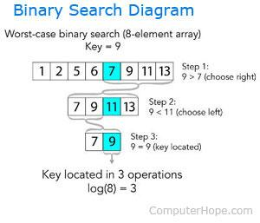
Complexity Analysis of Binary Search
Best case:
Worst Case:
‹#›
Notes:
‹#›

Slide 21
Features of Binary Search
It is great to search through large sorted arrays.
It has a time complexity of O(log n) which is a very good time complexity.
It has also a simple implementation.
‹#›
Notes:
‹#›

Slide 22
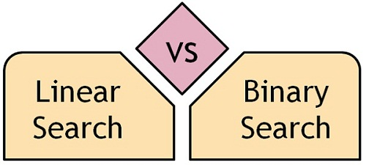
‹#›
Notes:
‹#›

Slide 23
‹#›
Notes:
‹#›

Slide 24
Complexity Analysis of Two Algorithms
Algorithm | Best case | Worst case
Linear search | O(1) | O(N)
Binary search | O(1) | O(log N)
‹#›
Notes:
‹#›

Slide 25
Try to answer!
If we have an array of length 70000000 but sorted, which searching algorithm will work fast and why??
Which Searching Algorithm is followed to search any data from a Dictionary?
Search item 75 using binary search algorithm from the following list.
A= [22, 3, 127, 515, 163, 69, 75, 88, 96, 10]
‹#›
Notes:
‹#›

Slide 26
Try to answer!
Search 30 from the list using Binary Search. Show each step.
10 | 15 | 21 | 25 | 30 | 40 | 51 | 60
‹#›
Notes:
‹#›

Slide 27

Thank you!
‹#›

